Slide 1
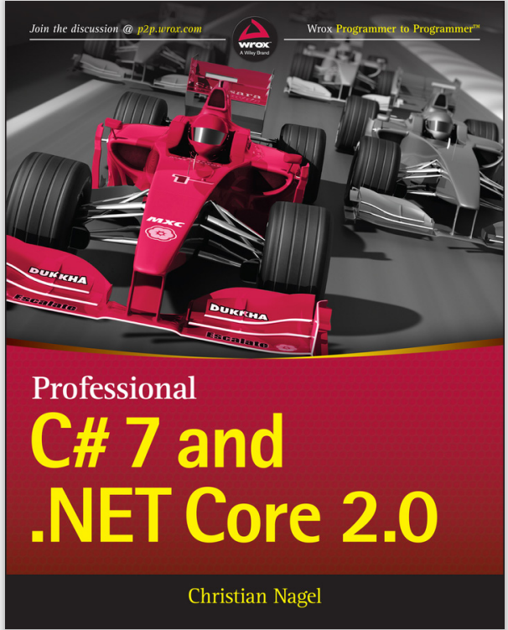
Programming
Lecture 3
Introduction to C# and .NET

Slide 2
Topics
Introduction to C# and .NET
Features of C#
.NET Framework
C# basic syntax
Basic usage of Visual Studio .NET
Basic features
Create a new project
Compile & Run
Basic of debugging

Slide 3
Introduction C#
Introduced in 2000 by Microsoft
Has roots in the C, C++, and Java
It’s appropriate for the most demanding app-development tasks
Large-scale enterprise
Web-based, mobile and “cloud”-based apps

Slide 4
Object-Oriented Programming
C# is object oriented
C# has access to the powerful .NET Framework Class Library
Vast collection of built-in classes to develop app quickly
We will learn more about .NET Framework later

Slide 5
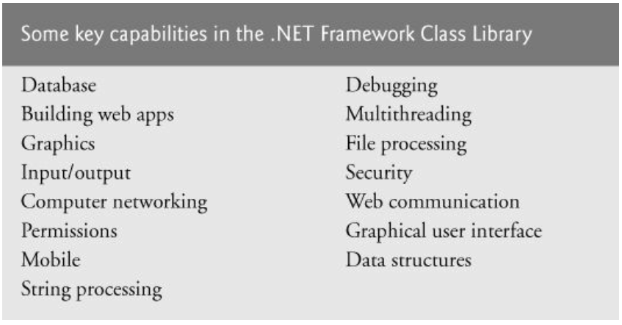

Slide 6
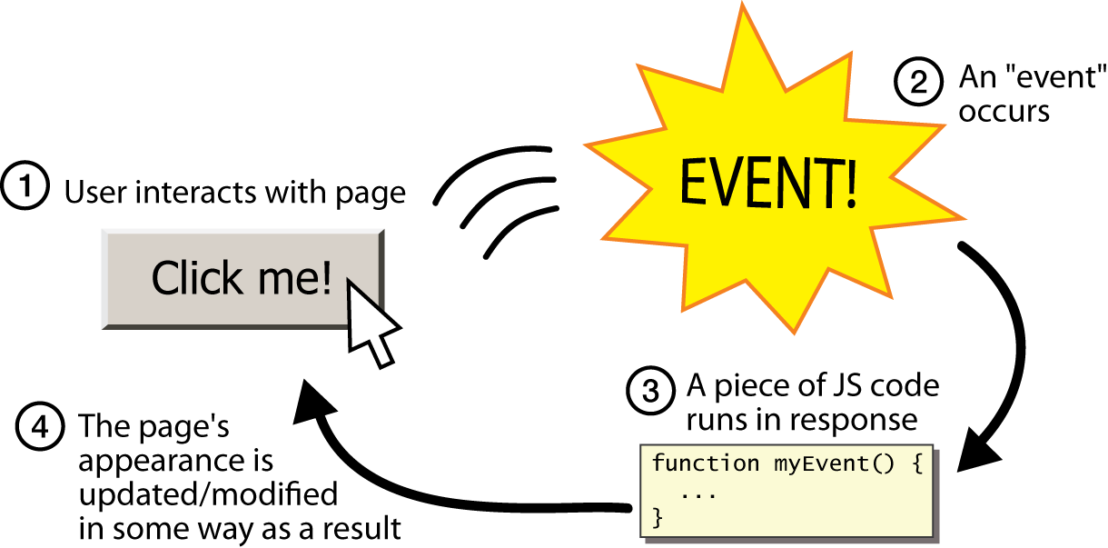
Event-Driven Programming
C# is event driven.
We write programs to respond to user-initiated events e.g., mouse clicks, keystrokes, timer expiration, etc
Or touches, finger swipes, etc on smartphones
C#

Slide 7
Visual Programming
C# is visual programming language
You can write code
You can also use VS to drag/drop and design GUI
Then VS will write the GUI code for you
Allows us to focus on coding business processing

Slide 8
An International Standard
C# has been standardized internationally
Enables other implementation of language besides MS’s Visual C#
One example is Mono that runs on Linux, iOS, Android, and Windows

Slide 9
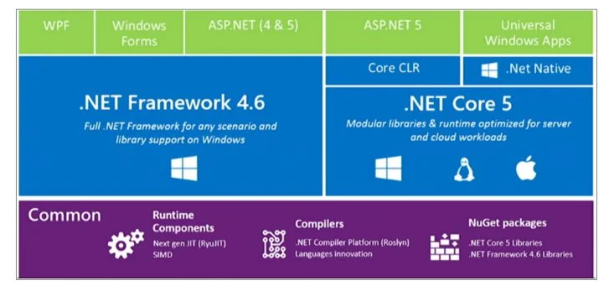
How C# works
Notes:
Các ngôn ngữ NET như C#, VB.NET, VJ#, VC++ .NET có cách thức hoạt động giống nhau và là một thành phần của .NET Framework do đó bạn không thể chạy các ứng dụng này trên các máy không chạy cài đặt .NET Framework version thích hợp

Slide 10
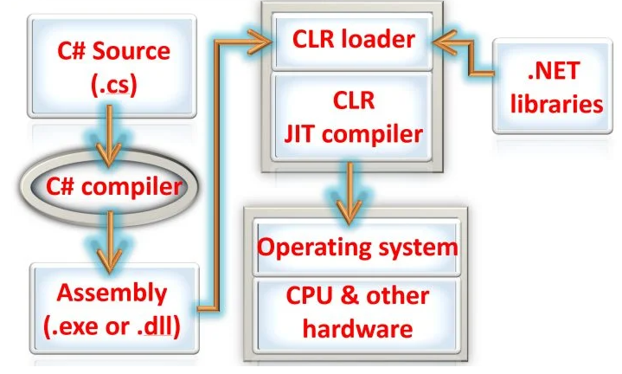
How C# works
Notes:
Đầu tiên nhà phát triển viết code bằng ngôn ngữ lập trình. Sau đó trình biên dịch sẽ biên dịch thành ngôn ngữ trung gian chung (CIL).CIL được biên dịch một nửa và không thể thực thi trực tiếp bởi hệ điều hành Nếu là C# sẽ là CSC, nếu là VB sẽ là VBC.
Để thực thi CIL thì .NET cung cấp CLR (trình thực thi ngôn ngữ chung). CLR lấy mã CIL và đưa nó một trình biên dịch JIT (Just in time).JIT đọc mã CIL và chuyern thành mã máy

Slide 11
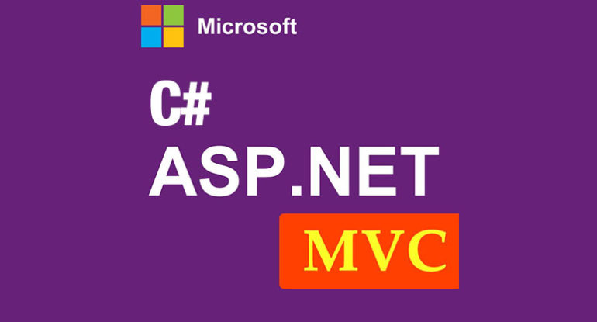
Internet and Web Programming
We can build web based app with C# and Microsoft’s ASP.NET technology

Slide 12
Microsoft’s .NET

Slide 13
Introduction
In 2000 by Microsoft announce .NET initiative
Broad vision for using the Internet and the web in the development, engineering, distribution and use of software
.NET permits you to create apps using any .NET-compatible langue (C#, Visual Basic, Visual C++…)
Part of the initiative includes ASP.NET technology

Slide 14
.NET Framework
It executes apps and contains the Class Library
.NET Framework Class Library
Contains many valuable prebuilt classes
These classes are tested and tuned
These speedup the development & performance

Slide 15
Common Language Runtime (CLR)
CLR is another key part of the .NET Framework
Executes .NET programs and provides functionality to make easier to develop and debug
CLR is a virtual machine (VM)
It manages execution of programs and hides from them the underlying operating system hardware
Source code are executed/managed by CLR is called managed code.
CLR provides many services to managed code
Integrating software components written in different .NET languages
Error handling between such components
Enhanced security
Automatic memory management
Etc.

Slide 16
Managed Code to Machine Instruction
Managed code is compiled into machine-specific instructions in following steps
First code is compiled into MSIL (all C#, J#, etc will be compiled into MSIL)
When the app executes, JIT compiler in the CLR translates MSIL into machine code
The machine code executes on that platform
C#, VB.NET,etc
MSIL Source
Machine Language
C# or VB.NET compiler
JIT in CLR

Slide 17
Platform Independence
.NET Framework exists and is installed for a platform
.NET is platform independence
Ability to run across multiple platforms
E.g., we can install .NET in Mac OS

Slide 18
Language Interoperability
.NET Framework provides high level language interoperability
Software can be written in C#, Visual Basic, etc
All will be compiled into MSIL

Slide 19
C# Basic Syntax

Slide 20
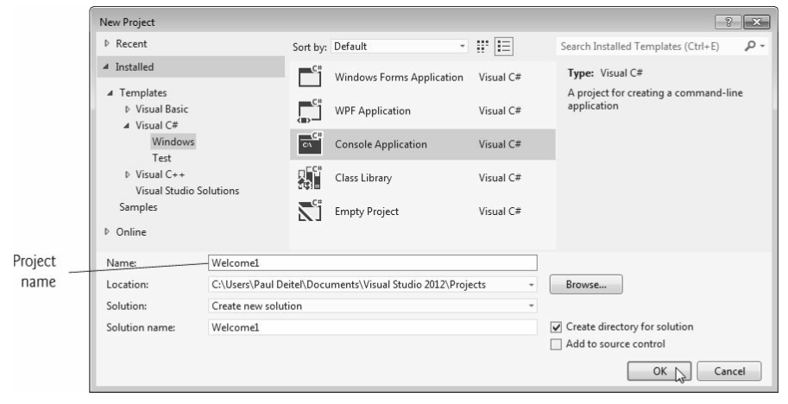
Creating a new app

Slide 21
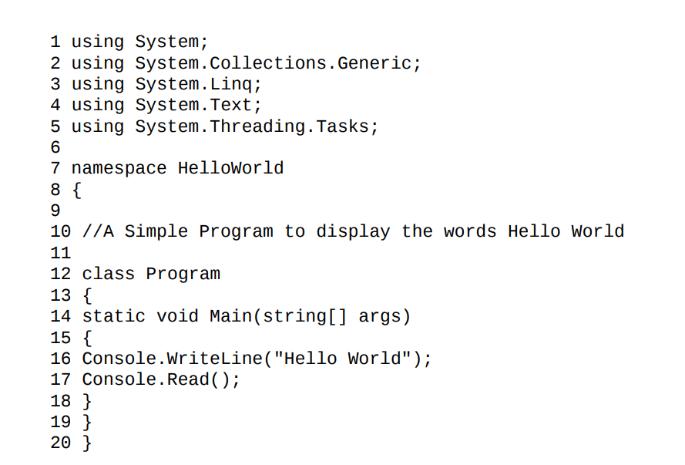
The source code
http://csharp-station.com

Slide 22
using Directive
From line 1 to 5, we have a few statements that start with the word using. These statements are known as directives. They tell the compiler that our program uses a certain namespace
For instance, the first line
using System;
tells the compiler that our program uses the System namespace.

Slide 23
Namespace
A namespace is simply a grouping of related code elements. These elements include classes, interfaces, enums and structs etc
C# comes with a large amount of pre-written code that are organised into different namespaces.
The System namespace contains code for methods that allow us to interact with our users. We use two of these methods in our program - the WriteLine() and Read() methods

Slide 24
Class declaration
Every app consists of at least one class declaration that defined by the programmer
user-defined class
E.g., public class Welcome1
Class Name convention (upper camel casing)
Begin with a capital letter
Capitalize the first letter of each word included
Contains letters, digits, and underscore
Doesn’t start with digit, doesn’t contain spaces
C# is case sensitive
So be careful because Myname is different from MyName

Slide 25
C# Method and Statements
Main method
public static void Main(string[] args)
It’s the starting point of every app
Statements
Statements end with a semicolon (;)

Slide 26
statements/comments
Statement is instruction that programmer tells computer to do
Every C# statement is terminated with semicolon ‘;’
Comment is explanation / guide that programmer explain to reader some block of code and comments will not be executed
Comment a single line with //
Comment a block with /*….......*/

Slide 27
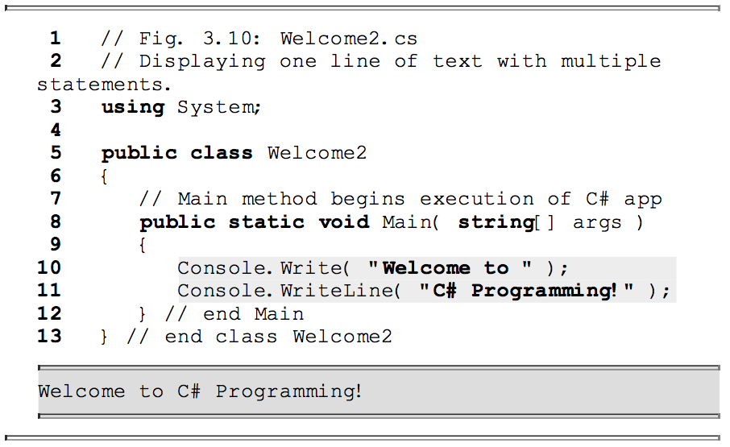
Multiple Line Statement

Slide 28
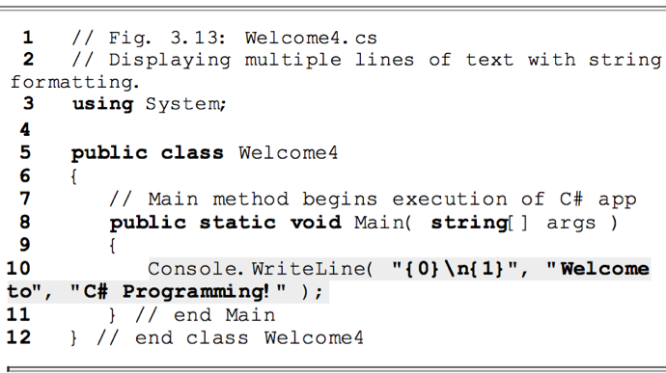
Formatting Text

Slide 29
Displaying Output
Most applications require some input from the user and give output as a result. To display text to the console window you use the Console.Write or Console.WriteLine methods.
The difference between these two is that Console.WriteLine is followed by a line terminator, which moves the cursor to the next line after the text output.
The program below will display Hello World! to the console window:

Slide 30
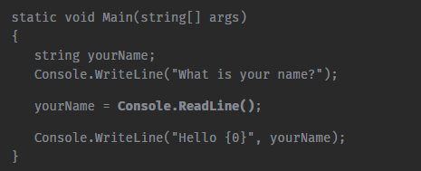
User Input
You can also prompt the user to enter data and then use the Console.ReadLine method to assign the input to a string variable. The following example asks the user for a name and then displays a message that includes the input:

Slide 31
User Input
The Console.ReadLine() method returns a string value. If you are expecting another type of value (such as int or double), the entered data must be converted to that type.
This can be done using the Convert.ToXXX methods, where XXX is the .NET name of the type that we want to convert to. For example, methods include Convert.ToDouble and Convert.ToBoolean.
For integer conversion, there are three alternatives available based on the bit size of the integer: Convert.ToInt16, Convert.ToInt32 and Convert.ToInt64. The default int type in C# is 32-bit.
Notes:
Int.Parse

Slide 32
Read the input
For standard input we use Console.ReadLine()
String s = Console.ReadLine();
int n = Convert.ToInt32(Console.ReadLine());
Possible erroneous input
User can input a string which is not an integer
In this case an Exception is raised
We will learn about handling exception later

